Slide 1
Climate Change Sentiments Amongst the 116th US Congress
Tony Lai, Isaac Manly, Arnav Sharma

Slide 2
Problem and Background
What can we learn about information sources of climate change that people trust and internalize?
We want to...
Empower people to understand the bases of their representatives’ views
Evaluate politicians and track misinformation
We focus on U.S’ 116th Senators as figures of “trust”, seeking to learn how politicians view climate change, and how they publicly express said views in relation to one another.
Notes:
Arnav

Slide 3
Initial Plan
Collect Twitter data from the 116th US Congress, including all tweets related to the climate and their like counts, as well as the network of followings/ers between members.
Use sentiment analysis to determine the view of climate change / climate action in the tweets of each member
Visualize a network which encapsulates the follow relationships between members, while also displaying their climate sentiment, influence (likes), and political affiliation
Notes:
Arnav

Slide 4
Hurdles and Adaptations
Getting twitter dev access was harder/time consuming than we thought
Alternate API access tools are unreliable
Data is hard to source; hard to clean and parse; large.
Being programmatic was sometimes not worth the effort; manual data entry for party affiliation.
Relevant tweets were based on keywords, so may be incomplete
Traditional sentiment analysis largely inaccurate
Trained a stance classifier to address this inaccuracy
Notes:
Arnav

Slide 5
Overview
Data Acquisition
Data Preprocessing
Modeling
Twitter Developer accounts
Twarc and Tweepy
Sourcing data online
Scrape senator tweets and ‘Friends’
Process tweets
Drop stop words
Apply lower casing
Manually apply political stance
Lemmatization
tf-idf vectorization
Sentiment Analysis classifier
Network modeling
Notes:
Arnav
Drop stop words - removing irrelevant words
Lemmatization - de-tense (return to base form)
Term frequency inverse document frequency -> each tweet becomes a matrix of term frequency

Slide 6
Acquisition
Used a combination of python packages Twarc and Tweepy to gather Senator’s tweets
180 Twitter accounts of 116th Congress Senators pulled from public dataset found in Harvard’s Dataverse
~82 Twitter accounts after cross-referencing it against official Wikipedia entries of senators’ Twitter UID
Scraped ~500,000 tweets
Sourced from a variety of databases in order to obtain financial data
Programatically injected a dataset of >400 individuals constituting the 116th Congress and their financial campaigns via Federal Election Comission (FEC)
Manually input political affiliation of all senators from Wikipedia
Identified tweets by keywords: ‘global’, ‘warming’, ‘climate’, ‘change’
Identified ~11,000 related to climate change
Shown by Cody et al., 2015 to have high precision in identifying climate related tweets
Notes:
Tony
Based on our premise, we knew we had to capture Twitter data about senators, as well as auxiliary information about them. This entailed things like political affiliation and financial contributions, since we believed those were traditionally the biggest factors for one’s stance on climate change. As a result, we had to reference Wikipedia, the Federal Election Commission (FEC). We used the former for political affiliation, and the latter for their campaign contributions.
For the Twitter data, this was a matter of firstly obtaining a dataset containing all the Twitter handles of the 116th Congress’ Senators. Thankfully, this was found on Harvard’s Dataverse. However, this resulted with 180 Twitter accounts. For reference, there are 100 senators at any given time. As such, we whittled it down to 82 accounts after validating it against Wikipedia and CSPAN entries for senator Twitter handles.
Finally, we utilized a set of words to query our Tweets from our senators by. Of the 500,000 scraped, 11,000 ultimately pertained to the words we had provided.

Slide 7
Acquisition, Cont’d.
Issues with Tweepy & Twarc
Rate limiting; time outs were necessary given the 450-requests-per-15 minute interval we had.
Twarc took 7 hours to scrape Tweets.
Veracity of datasets
Some of the data was incomplete (e.g: @LeaderMcConnell vs. @McConnellPress)
Campaign finance contributions are not wholly accurate (e.g: Ted Cruz received 0 funding)
Issues with consolidating data
We had to relate Twitter Handles, names, and finances. Only thing in common in all these data sets was name.
Senators had different aliases in both their formal registration within the FEC and in common discourse. e.g:
Bernie Sanders (Common) / Bernard Sanders (FEC)
Ted Cruz (Common) / Rafael Edward “Ted” Cruz (FEC)
Notes:
Tony
There were three main problems involved in data acquisition. Primarily time constraints with Tweepy / Twarc, the two APIs we used to obtain Twitter data, as well as inaccuracies within our sources of data prior to our processing, and aggregating the data we derived from the sources.
The first issue was pretty self explanatory; because Twitter sets rate-limits for the amount of queries that can be made towards its database, so we had to stagger our calls for both identifying relationships between senators on Twitter, as well as scraping Tweets. This ended up taking about 2 hours for obtaining relational data about our senators, and 7 hours for the tweets.
Secondly, some of the data wasn’t wholly accurate. Namely, the database used to verify official Twitter handles, as well as the financial database (though this was directly provided by the Federal Election Commission). For instance, Mitch McConnell was slated as having the official Twitter handle @McConnellPress despite @LeaderMcConell seeming to be the de facto account that McConnell uses for public engagement.
Lastly,
Since the datasets involved in validating official accounts concerned themselves with both Senate and House, it was difficult to
Had to relate twitter handle, to financial data. 2 disparate data sets. As a result, it became a challenge to figure out how to link
Build out a 2 step process: get the name returned from Twitter handle, and then get the finances returned from the name.
Didn’t resolve all issues though; names differed from formal registration to Wikipedia entry.
Eventually settled on using a heuristic of last name to hash; creating two hashtables between twitter handle and name, and then name and finances. There was only 1 duplicate in all 100 senators, so it made it an appropriate choice when trying to expedite lookups.
This conferred a benefit of constant lookup, between
NOT exhaustive though! Some cracks fell through when trying to programmatically input data. Some names are registered differently to how
Difficulty programmatically inputting data

Slide 8
Pipeline Visualization
output: financeDict[lastNameDict[“SenSanders”]] = 218907026.62
output: financeDict[lastNameDict[“SenSanders”]] = 218907026.62
SenSanders,29442313,https://twitter.com/SenSanders
Input: SenSanders
Output: SenSanders
Hashtable here consisted of data pulled from a csv file with name and Twitter Handle looked like this. Stored data with key:value of Twitter Handle : Last Name.
// input from csv as row. Indexing to access each element
LastName = row[0].upper().split(“ ”, 1)[1]
TwitterHandle = row[5]
dict[TwitterHandle] = LastName
dict[“SenSanders”] = “SANDERS”
Bernie Sanders ,Sen,3-Jan-07,SenSanders,SenSanders,SenSanders,SenSanders,
Input: SenSanders
Output: SANDERS
P60007168|SANDERS, BERNARD|C|1|DEM|218907026.62|12701500|221001358.61|6601500|4743726.76|2650205.79|0|0|0|0|0|0|202554495.98|00|00||||||14702.52|0|12/31/2020|4428413.87|0
Like above, we pulled the last name from the csv file, and then instantiated a hashset based in the key:value pair of
Last Name : Contributions.
LastName = row[1].split(',')
Contributions = row[5]
dict[LastName] = Contributions
dict[“SANDERS”] = 218907026.62
Input: SANDERS
Output: 218907026.62
Notes:
Tony
Trace through the input to output...

Slide 9
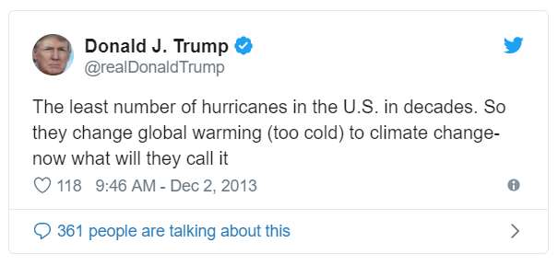
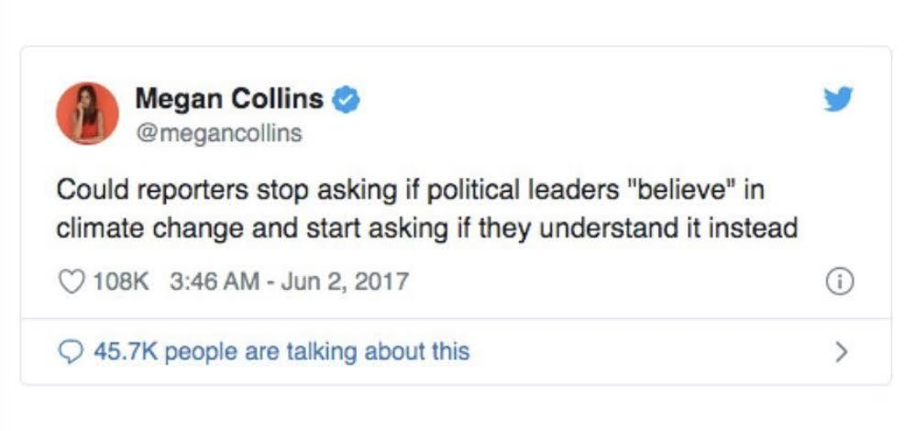
Sentiment Analysis
The topic of climate change is well recognized as intractable to traditional sentiment analysis
Our project requires a specialized method to identify stances toward climate change
Notes:
Isaac

Slide 10
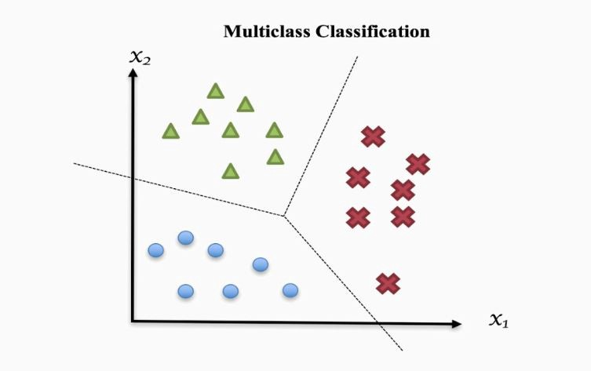
SVM
Looks to maximize the hyperplane
Chosen because of positive historical performance in sentiment analysis
Notes:
Isaac

Slide 11
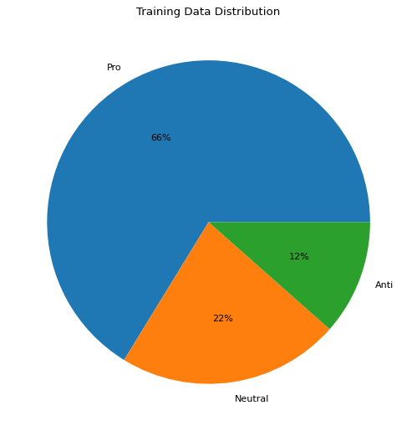
Training data from the University of Waterloo
Imbalanced
~34,000 samples
Labeled manually by 3 independent researchers
Notes:
Isaac

Slide 12
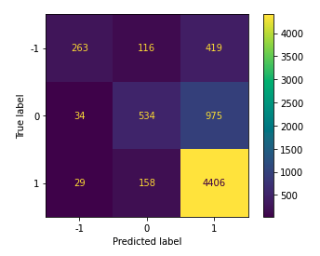
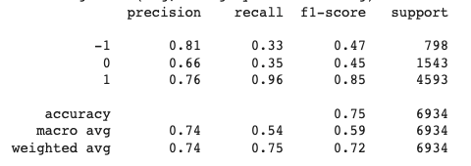
Climate Stance Classifier With SVM
Pro: 1
Anti: -1
Neutral: 0
High accuracy due to majority class
Low recalls due to data imbalance
Notes:
Isaac

Slide 13
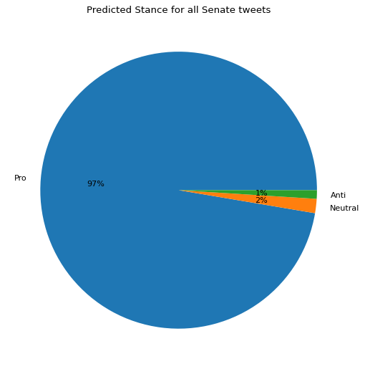
Stance Classifier applied to Senator Tweets
Democrats had 7527 tweets
Republicans had 3118 tweets
Aggregated stance per senator is the average of their stances on each tweet:
Average(# of Pro, # of Neutral, # of Anti)
Notes:
Isaac

Slide 14
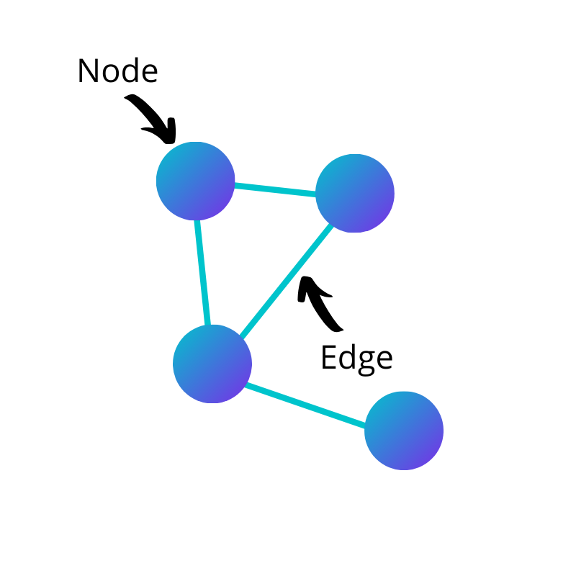
Network Implementation
NetworkX
Nodes: Senators
Hue: Party
Edge: Following on twitter or “Friend”
Notes:
Arnav
Senators (personal + campaign/press separate nodes) 100 v 170

Slide 15
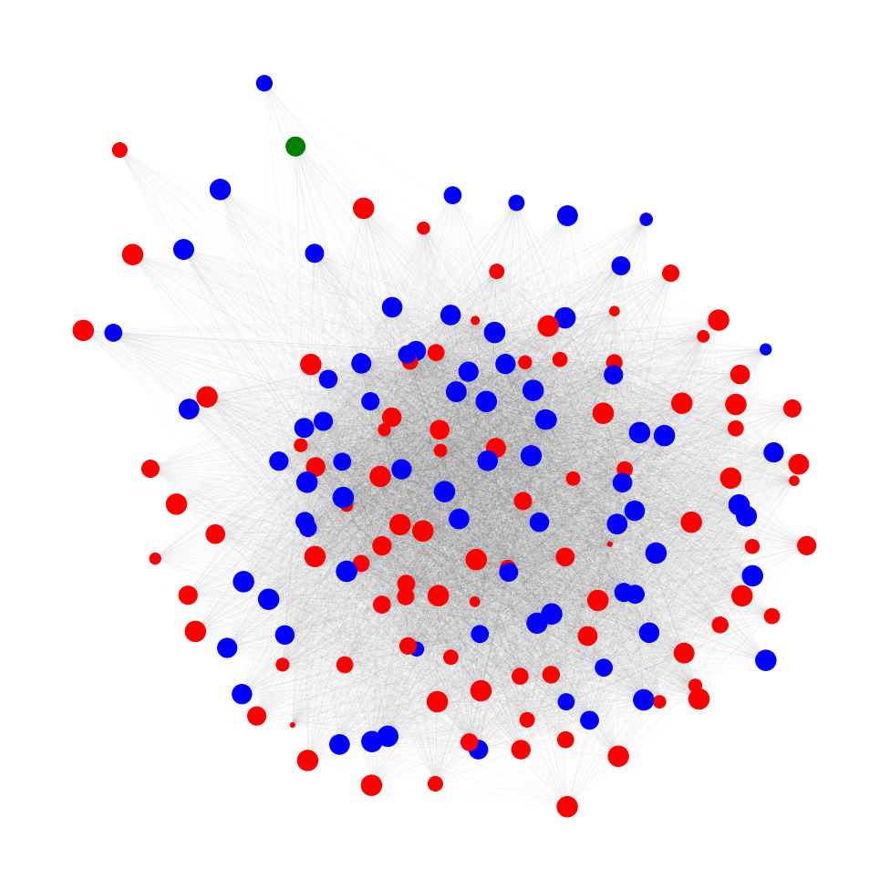
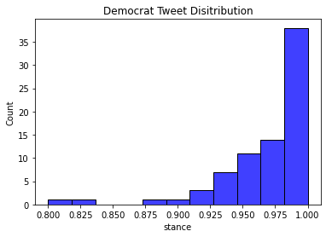
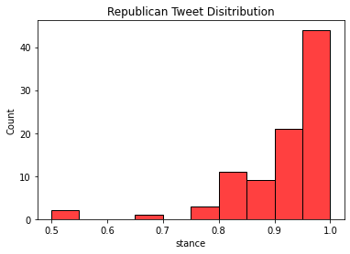
Network 1: Size by Stance
Notes:
Arnav
-Generally fairly uniform, but Republicans are smoller, less proclivity towards climate action

Slide 16
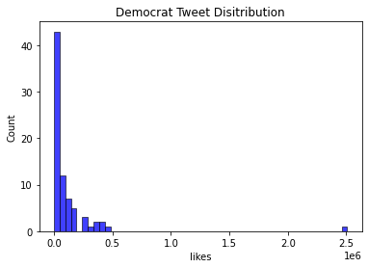
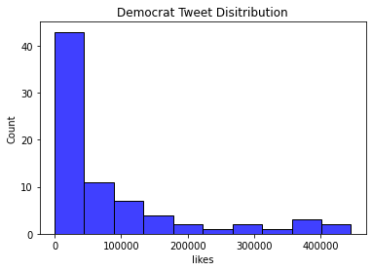
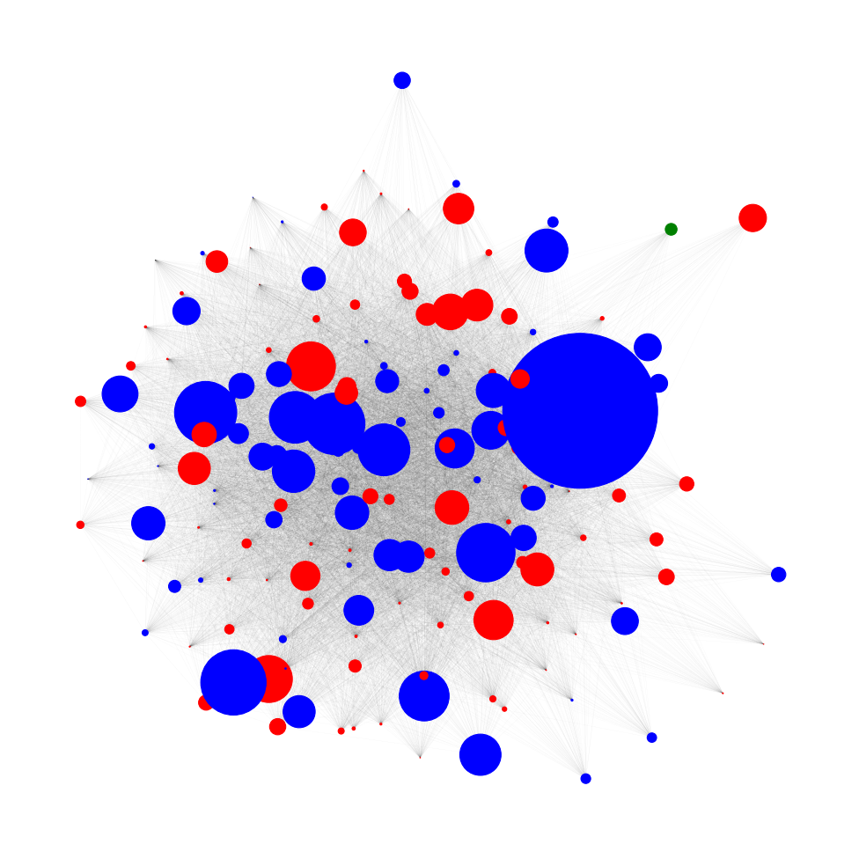
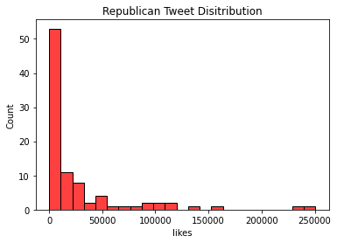
Network 2: Sizes by likes
Notes:
Arnav
Brian Shatz is biggest blue circle (has the most likes), very pro-climate action

Slide 17
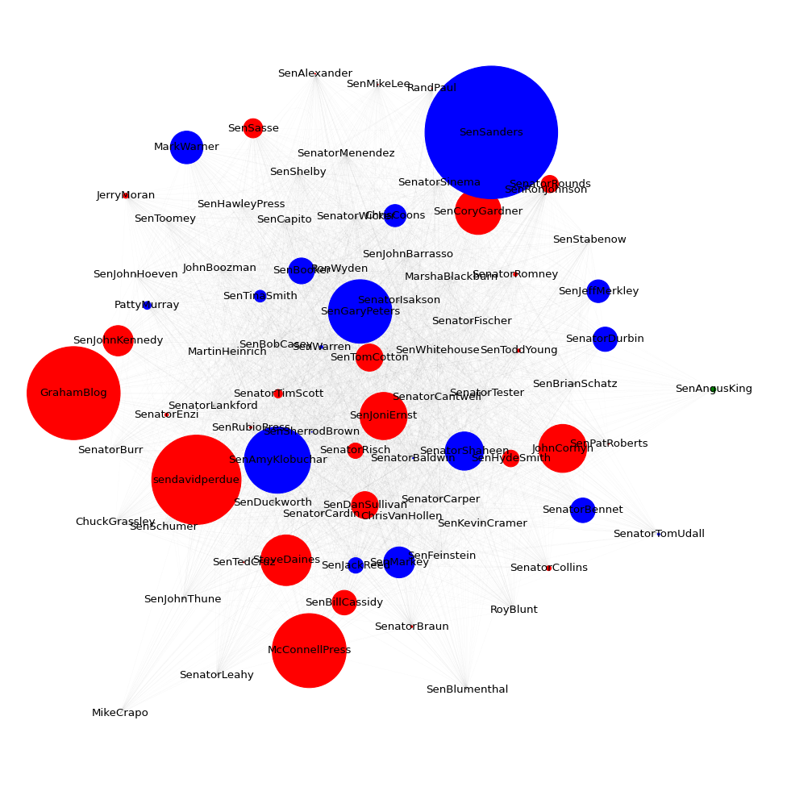
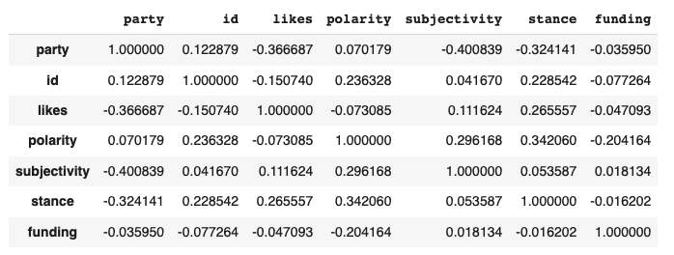
Network 3: Sizes by FEC Contributions
Notes:
Tony
Correlation matrix
Using raw quantity to proxy
Talk about the funding data; discrepancies

Slide 18
Discussion of Findings
Results could be impacted because of inherent bias of internet leaning towards affirming climate change.
Engagement for Democrat tweets regarding climate change was far higher than Republican ones.
Sentiment on climate change was not dramatically tied to political affiliation nor contributions
While Republicans tended to stray away from strong stances of affirming climate change (<1), none fell into climate denial designations (<0).
Could break down contributions further; not all donors are the same.
Personal accounts also reflect the views, or more official accounts
Notes:
Tony

Slide 19
Improvements and Future Work
Computational limits
Upsampling techniques could prove useful
Explore additional keywords to identify climate related tweets
Expand scope to the house of representatives
Create a more advanced and accurate classification model for sentiment analysis
Deep Learning, gradient boosted methods
Notes:
Tony

Slide 20
Q & A

Slide 21
References
https://www.kaggle.com/edqian/twitter-climate-change-sentiment-dataset
https://dataverse.harvard.edu/dataset.xhtml?persistentId=doi:10.7910/DVN/MBOJNS
https://networkx.org/
https://journals.plos.org/plosone/article?id=10.1371/journal.pone.0136092
https://www.fec.gov/campaign-finance-data/campaign-finance-statistics/
http://election-finance.com/candidates/P60007168/
https://github.com/oduwsdl/US-Congress
Notes:
Tony

